Slide 1

Online game addiction
22140003
Sentaro Sakura

Slide 2
Introduction
What is online(internet) addiction?
Is the compulsive need to spend a great deal of time on the Internet
causes stress in one's personal, school, or work life
ex.) Computer Or Gaming Addiction, Online Relationship Addiction, Online Shopping Addiction, Online Gambling Addiction

Slide 3
How many people are addicted?
According to ministry of Health, Labour Standards in 2017, 2018
At least 930,000 junior, or high school students are online addicted
There were about 6,5million students in total
About 12 to 16%
Every 1 out of 7 junior or high school students are addicted
64,320 participants

Slide 4
Comparison with other issues
According to ministry of education in 2021
43,051(1.39%) students were recluse
517,163 case of bullies were reported

Slide 5
Symptoms
No longer engaging in activities that were once enjoyed
Spending most waking hours online
Anger or agitation if you are asked to step away from your device of choice
Lying about your internet use
Concealing your internet use

Slide 6
What are the cause?
Video games are designed to de addictive
Playing game releases dopamine
Poor social interaction
The ease of the access to the electrical devices

Slide 7

Research question
How can we deal with game addiction

Slide 8
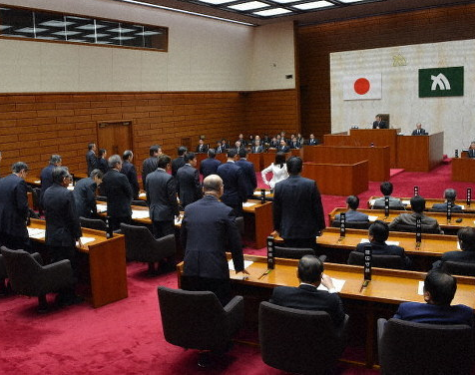
Local government action
Kagawa prefecture passed the law to limit kids playing game to 1 hour.
It is aimed to deal with ;
gaming addiction
Poor vision level of kids
The increase of number in social recluse

Slide 9
The result of the law in Kagawa
Usage time
users who spend more than 3 hours per day has decreased by 10.6%
users who spend 1-3 hours per day has increased by 10.9% in high school.
From Kagawa board of education

Slide 10
The result of the law in Kagawa
Internet addiction test result
students who have tendency of internet addiction:
increased from 3.4% to 6.3% in junior high school
increased from 2.9% to 4.6% in high school
From Kagawa board of education

Slide 11
Professor’s suggestion
Sumioka Koh from seijo sumioka clinic pointed out:
“the environment in which children interact with digital devices is important in their early years, and it is unlikely that children will reduce the amount of time they spend using these devices just because there is an ordinance in place.”

Slide 12

Advantages of playing games
get used to using electric devices
Improved cognitive abilities
Increased hand-to-eye coordination
Improved problem-solving skills and logic
Faster and more accurate decision-making
From University Nijmegen

Slide 13
Games as education
School in sweaden;
Minecraft became a compulsory class in 2013
increases the ability of planning
increases creativity
get used to typing
active learning

Slide 14
Using game for education
Maintain children’s motivation
Opportunities to teach how to manage time of game properly.
Easy to get started
Play games properly

Slide 15
Discussion Questions
Do you think internet addiction overweight the advantages of games?

Slide 16
conclusion
No more regulations are needed
Try to make use of games for education
Encourage kids to play games propery and safely

Slide 17
References
Kumar, M. (2018). A study on Internet addiction and its relation to psychopathology and self-esteem among college students (1st ed.). Wolters Kluwer.
Granic, I., Lobel, A., & Engels, R. C. M. E. (2013). The Benefits of Playing Video Games. American Psychologist, 69. https://doi.org/10.1037/a0034857
総務省 情報通信政策研究所 （２０１３）「青少年のインターネット利用と依存傾向に関する調査、URL：https://www.soumu.go.jp/iicp/chousakenkyu/data/research/survey/telecom/2013/internet-addiction.pdf（参照日：２０２３年１月１５日）

